Slide 1

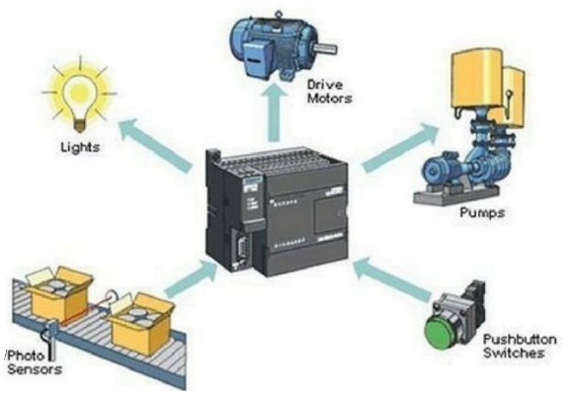
MBEYA UNIVERSITY OF SCIENCE AND TECHNOLOGY COLLEGE OF ENGINEERING AND TECHNOLOGY DEPARTMENT OF MECHANICAL AND INDUSTRIAL ENGINEERING MODULE_ME 6215: Programmable Logical Controller I
COURSE CREDIT: 07
Prepared by;
Dr. Masoud Kamoleka Mlela
BSc. Electromechanical Engineering (UDSM)
MSc, Renewable Energy (UDSM)
PhD, Mechanical Engineering (HEU-CN).
Lecture 2

Slide 2
Various INPUT /OUTPUT Devices and its interfacing with PLC

Slide 3
Programmable Logic Controllers (PLCs) interact with industrial processes through input/output (I/O) devices, which monitor conditions and execute control actions. Below is a detailed breakdown of common I/O devices, their specifications, and interfacing methods with PLCs.

Slide 4
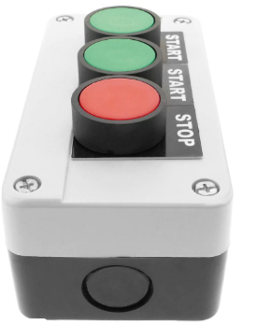
Input Devices
Switches
Push Button Switches: Momentary contacts for manual control (e.g., start/stop). Typically, 24VDC digital inputs (DIs) wired to PLC DI modules.

Slide 5
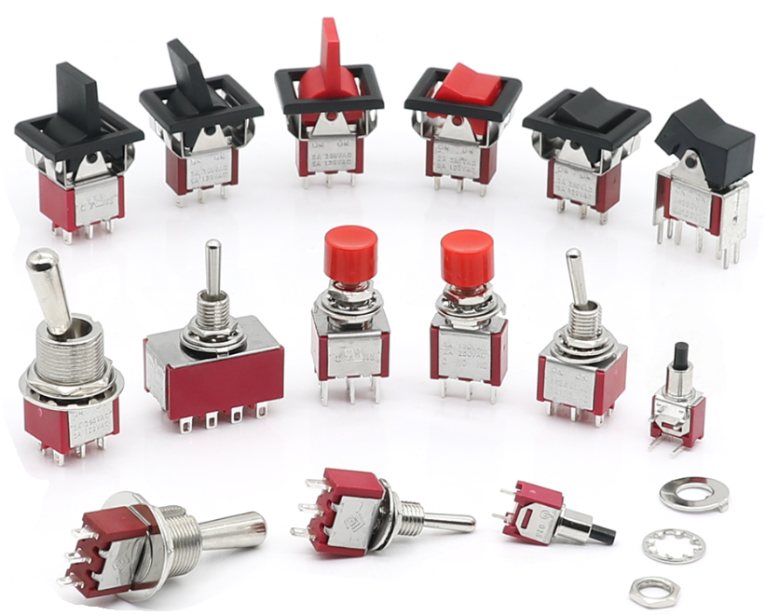
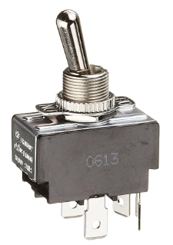
Input Devices
Switches
Toggle Switches: Maintained contacts for manual state selection. Often passive DIs requiring external power.

Slide 6
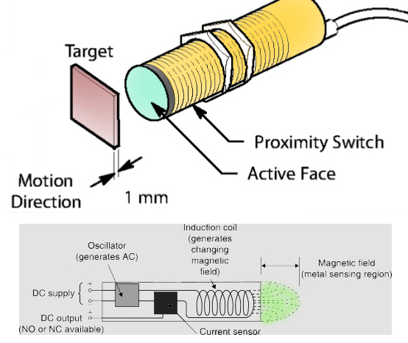
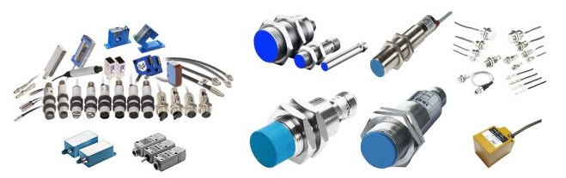
Input Devices
Switches
Proximity Switches: Detect object presence without contact. Active DIs (24VDC) with PNP/NPN output configurations.

Slide 7
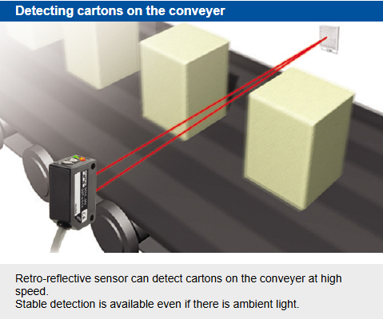
Input Devices
Switches
Photo Switches: Use light beams for object detection. High-speed digital inputs (up to 10kHz) for counting applications.

Slide 8
Input Devices
Switches
Temperature/Pressure/Level/Flow Switches: Provide binary signals (ON/OFF) based on threshold conditions. Active DIs with built-in signal conditioning

Slide 9
Input Devices
Sensors and Transmitters
Temperature Sensors (RTDs, Thermocouples): Generate analog signals (e.g., 4–20mA) for precise monitoring. Require analog input (AI) modules with signal isolation.
Pressure/Level Transmitters: Convert physical parameters to analog signals (0–10V or 4–20mA). Connected to PLC AI modules for continuous monitoring
Motor Starters
Provide status feedback (e.g., overload) via auxiliary contacts. These contacts are wired as DIs to monitor motor state

Slide 10
Output Devices
Relays
Electromagnetic Control Relays: Switch AC/DC loads using PLC digital outputs (DOs). Common ratings: 10A at 250VAC. Relay outputs (dry contacts) allow mixed voltages but have slower response (~10ms).
Latching Relays: Maintain state without continuous power. Programmed using OTL (Latch) and OTU (Unlatch) PLC instructions.
Contactors
High-current switches for motors/pumps. Controlled by PLC DOs (24VDC) energizing the contactor coil. Auxiliary contacts provide feedback to PLC inputs.
Specifications: Typically, 20–100A at 480VAC. Require overload protection for safe operation

Slide 11
Output Devices
Solenoid Valves
Actuated by PLC DOs (transistor outputs for fast switching). Rated for 24VDC/120VAC, with currents under 1A. Often interfaced via relays for isolation.
Motors and Pumps
Controlled through contactors/VFDs. VFDs use analog outputs (0–10V or 4–20mA) from PLCs for speed control.

Slide 12
Interfacing Guidelines
Input Wiring
Digital Inputs:
Passive devices (e.g., toggle switches) require external 24VDC power.
Active devices (e.g., proximity switches) self-power and connect directly to DI modules
Analog Inputs:
4–20mA signals use shielded cables to reduce noise. Configure PLC AI modules for current/voltage input

Slide 13
Interfacing Guidelines
Output Wiring
Relay Outputs: Suitable for mixed AC/DC loads but limited to 10A. Use separate relays for high-power devices.
Transistor Outputs: Fast switching (<1ms) for DC loads (e.g., solenoids). Current-limited (≤1A), often requiring external drivers.
Safety Considerations
Isolate high-voltage circuits using relays/contactors.
Match PLC output ratings (voltage/current) with device requirements to prevent damage.
This integration of I/O devices with PLCs enables precise automation, leveraging digital and analog signals for robust industrial control.

Slide 14



